Slide 1
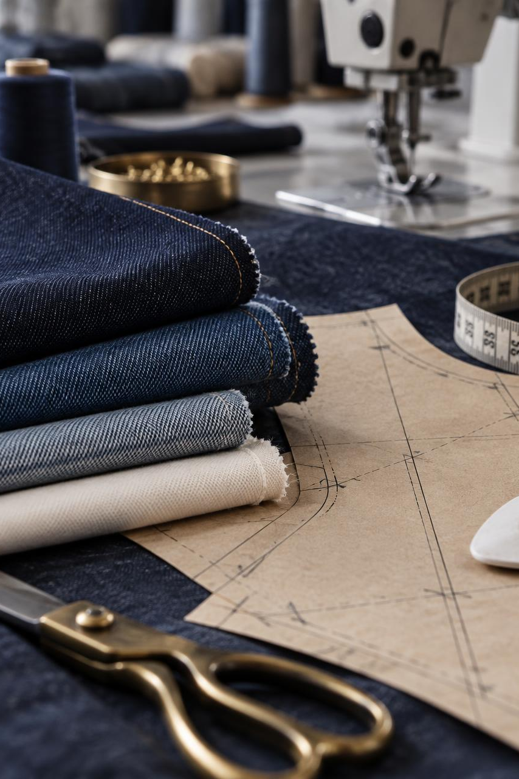
NOSK.life
Your guide to
garment learning
Garment Tech Ed & Garment Ed
How to start, keep learning
and record your achievement
NOSK.life / GARMENT EDUCATION
01
Notes:
Learner orientation for the two NOSK.life education hubs. Course links use the accessible platform at garmenteched.com.
Sources reviewed 19 September 2026:
https://garmenteched.com/garmented
https://garmenteched.com/garment-technology
https://garmenteched.com/assets/garmented-hero-fabric-q4zBCqIh.jpg

Slide 2
LEARNER GUIDE
Two hubs, different starting points
Garment Tech Ed
Garment Ed
For technology and the value chain.
Explore industry chapters, the 42-stage journey or a themed course.
For a job role or subject.
Choose a focused course, use a role pathway or follow GarmentEd 360.
NOSK.life / GARMENT EDUCATION
02
Notes:
Sources reviewed 19 September 2026:
https://garmenteched.com/garment-technology
https://garmenteched.com/garmented

Slide 3
LEARNER GUIDE
Starting, enrolling and signing in
Start learning
Open the syllabus and read. The free learning routes do not require an account to begin.
Enrol free
Use the course enrolment link if you want to register your interest. Complete the details the page requests.
Sign in
Use a free learner account to carry progress between devices. Enrolment and account creation are separate.
NOSK.life / GARMENT EDUCATION
03
Notes:
The FAQ describes one-click enrolment, but the live enrolment pages request name and email. This guide avoids promising a single-click process.
Sources reviewed 19 September 2026:
https://garmenteched.com/garment-technology/enroll/ge-textile-technology
https://garmenteched.com/garment-technology/faq
https://garmenteched.com/garmented/360

Slide 4
GARMENT TECH Ed
Garment Tech Ed: your learning routes
30 chapters
Study technology subjects through the seven-module syllabus. Start with the chapter that fits your learning goal.
42 stages
Follow the garment journey from consumer demand through production, use and material recovery.
Guided courses
Choose a theme and work through its modules, readings and quizzes. Use My progress for course-specific requirements.
NOSK.life / GARMENT EDUCATION
04
Notes:
Sources reviewed 19 September 2026:
https://garmenteched.com/garment-technology
https://garmenteched.com/garment-technology/syllabus
https://garmenteched.com/garment-technology/courses

Slide 5
GARMENT TECH Ed
Five free guided courses
Circular Fashion: From Material to Recovery
14–18 hours
Sustainable Fashion: Evidence, Impact and Compliance
10–14 hours
Circular Economy in Garment Manufacturing
12–16 hours
Cost Economy of Garment Manufacturing
12–16 hours
Export & Trade Economy of Garment Manufacturing
12–16 hours
Each has six modules. Study times are estimates, at your own pace.
NOSK.life / GARMENT EDUCATION
05
Notes:
The separate paid Circular Fashion: Design to Recovery is not included in this free course list. Its enrolment was not open at review.
Sources reviewed 19 September 2026:
https://garmenteched.com/garment-technology/courses

Slide 6
GARMENT TECH Ed
A guided course, step by step
01 Choose
Open Guided courses, select a course, then open its syllabus or Start module 1.
02 Study
Read the linked chapters and value-chain stages. Use the completion control after finishing each reading.
03 Check
Answer the module quiz, check your score and review the explanations.
04 Continue
Open My progress. Follow the next module and complete the capstone when the course requires one.
NOSK.life / GARMENT EDUCATION
06
Notes:
Sources reviewed 19 September 2026:
https://garmenteched.com/garment-technology/courses
https://garmenteched.com/garment-technology/circular-fashion
https://garmenteched.com/garment-technology/training/circular-fashion

Slide 7
GARMENT TECH Ed
Circular Fashion: your finish line
6 module quizzes + a capstone
My progress shows the modules you have passed, chapters marked read and the capstone status.
The capstone asks you to redesign a garment style so its materials can be recovered at the end of use.
Follow the “Still to do” list for your course completion record.
NOSK.life / GARMENT EDUCATION
07
Notes:
Live progress screen: 0/6 quizzes, 0/14 chapters, capstone not yet. Its outstanding completion list requires all six quizzes and marking the capstone done. This is separate from the site-wide chapter/stage certificates.
Sources reviewed 19 September 2026:
https://garmenteched.com/garment-technology/training/circular-fashion

Slide 8
GARMENT Ed
Garment Ed: courses for everyday work
Quality & laboratory
Garment Quality Assurance and Laboratory Testing
Engineering & planning
Industrial Engineering and Production Planning for Garment Factories
Materials
Textile Technology for Apparel Manufacturing
Merchandising
Apparel Merchandising and Costing
These focused routes take approximately 10–16 hours, depending on the course.
NOSK.life / GARMENT EDUCATION
08
Notes:
Sources reviewed 19 September 2026:
https://garmenteched.com/garmented/courses

Slide 9
GARMENT Ed
Garment Ed: more specialist choices
Apparel Consumer Insight, Branding and Buying
Apparel Pattern Engineering and Sample Development
Apparel Design, Trend and Range Development
Garment Cutting-Room Technology and Control
Apparel Product Development and Technical Engineering
Garment Sewing Technology and Production Management
Apparel Sourcing and Supply Chain Management
Apparel Printing, Embroidery and Value Addition
NOSK.life / GARMENT EDUCATION
09
Notes:
Sources reviewed 19 September 2026:
https://garmenteched.com/garmented/courses

Slide 10
GARMENT Ed
A Garment Ed course, step by step
01 Find a course
Open Garment Ed, choose Courses or Find a course, then select View course.
02 Review the fit
Check the intended learner, level, study time and learning outcomes.
03 Start the syllabus
Select Start now — open the syllabus. Read each module’s subjects in the recommended order.
04 Track completion
Take the module quiz, then return to My progress to see the next module and remaining requirements.
NOSK.life / GARMENT EDUCATION
10
Notes:
Sources reviewed 19 September 2026:
https://garmenteched.com/garmented
https://garmenteched.com/garmented/courses
https://garmenteched.com/garmented/course/ge-textile-technology

Slide 11
GARMENT Ed
Example: Textile Technology
4 modules / 10 subjects / approximately 12–16 hours
1 Fibre and yarn
Understand how materials influence strength, stretch, pilling and shrinkage.
2 Fabric formation
Study woven, knitted and nonwoven constructions.
3 Wet processing
Understand dyeing, colouration and finishing.
4 Fabric quality
Connect inspection, testing and fabric selection to the end use.
NOSK.life / GARMENT EDUCATION
11
Notes:
Each module has a five-question quiz. Later modules recommend reading and passing the previous module first.
Sources reviewed 19 September 2026:
https://garmenteched.com/garmented/course/ge-textile-technology/syllabus

Slide 12
GARMENT Ed
The module quiz and your next step
4 out of 5
Answer all five questions, then select Check my answers.
Review the feedback and revisit any subject you need to strengthen.
My progress shows passed quizzes and the next module to study.
correct answers pass the textile
course’s module quiz
NOSK.life / GARMENT EDUCATION
12
Notes:
The 4/5 threshold was verified on the Textile Technology module page. Best score saves locally and to the account when signed in. Check the stated threshold on other course quizzes.
Sources reviewed 19 September 2026:
https://garmenteched.com/garmented/course/ge-textile-technology/module/fibre-yarn
https://garmenteched.com/garmented/course/ge-textile-technology/progress

Slide 13
GARMENT Ed 360
GarmentEd 360: the complete programme
20 modules
200+ lessons
Work through the apparel chain, then complete the
“From Buyer Brief to Shipment” capstone.
Pass each module assessment at 80%. Unlimited retries.
Sign in to claim the certificate with a verification ID.
NOSK.life / GARMENT EDUCATION
13
Notes:
The page gives a study-time estimate of 83 h 20 min. The programme requires lesson completion, module assessments and the capstone. It is self-study, not an accredited qualification.
Sources reviewed 19 September 2026:
https://garmenteched.com/garmented/360

Slide 14
LEARNER GUIDE
Keeping your place between visits
Same browser
Without signing in, your progress stays on that device and browser. Keep using the same one.
Across devices
Sign in to your learner account. If offered an import of local progress, choose only your own study record.
Returning to study
Use the course’s My progress link or the GarmentEd 360 My dashboard link, then continue the next module.
NOSK.life / GARMENT EDUCATION
14
Notes:
The FAQ says existing device progress remains separate until explicitly imported. Do not promise automatic merging. Browser storage can be lost if cleared; cross-domain storage must not be assumed to sync.
Sources reviewed 19 September 2026:
https://garmenteched.com/garment-technology/faq
https://garmenteched.com/garmented/360
https://garmenteched.com/garmented/course/ge-textile-technology/progress

Slide 15
LEARNER GUIDE
A simple weekly study routine
Plan your sessions
Choose one course and reserve two or three short study sessions each week.
Read and practise
Finish a subject, write a short note and relate it to a garment or factory task you know.
Review your progress
Check quiz feedback and the remaining modules. Record one question to resolve before continuing.
Suggested routine. These self-paced courses do not impose this timetable.
NOSK.life / GARMENT EDUCATION
15
Notes:
Suggested learning routine, not a platform feature or required timetable.
Sources reviewed 19 September 2026:

Slide 16
LEARNER GUIDE
What you can gain from the learning
Garment Tech Ed
Garment Ed
Understand how technologies fit into the production chain.
Evaluate material recovery choices, process impacts and technology trade-offs.
Strengthen knowledge for a specific role.
Apply learning to fabric decisions, inspection, production planning or garment costing.
Practical value grows when you apply the learning and review the result with your team.
NOSK.life / GARMENT EDUCATION
16
Notes:
Benefits are learning aims, not guarantees of promotion, employment, earnings or factory performance.
Sources reviewed 19 September 2026:
https://garmenteched.com/garment-technology/circular-fashion
https://garmenteched.com/garmented/courses

Slide 17
LEARNER GUIDE
What the completion records mean
Focused course
Follow that course’s progress checklist. The textile course requires passing every module quiz.
Technology pathways
The FAQ describes separate records for 42 stages, 30 chapters and completing both pathways.
GarmentEd 360
Finish the lessons, pass assessments and complete the capstone. Sign in for the named, verifiable certificate.
These are self-study completion records. They carry no accredited academic qualification.
NOSK.life / GARMENT EDUCATION
17
Notes:
Do not apply the FAQ’s statement that chapter self-checks do not affect certificates to course module quizzes. Different routes have different rules.
Sources reviewed 19 September 2026:
https://garmenteched.com/garmented/course/ge-textile-technology
https://garmenteched.com/garment-technology/faq
https://garmenteched.com/garmented/360

Slide 18
LEARNER GUIDE
Help when you get stuck
Progress looks missing
Return to the same browser, device and website address. Check your sign-in and local-progress import choice.
A quiz is incomplete
Answer every question before checking your answers. Revisit the reading and review the result.
A page will not open
Return to the course hub and try its direct module link. Report the page URL and the problem through Contact.
You need guidance
Use Learner FAQ or Contact. Include the course name, module and your question.
NOSK.life / GARMENT EDUCATION
18
Notes:
Learner dashboard returned a blank page during review. No successful sync, quiz submission or certificate download is asserted.
Sources reviewed 19 September 2026:
https://garmenteched.com/garment-technology/faq
https://garmenteched.com/garmented/course/ge-textile-technology/module/fibre-yarn
https://garmenteched.com/contact

Slide 19
NOSK.life
Your first lesson starts here
Garment Tech Ed
garmenteched.com/garment-technology
Garment Ed
garmenteched.com/garmented
Choose one course. Open the syllabus. Begin module 1.
NOSK.life / GARMENT EDUCATION
19
Notes:
Both pages carry NOSK.life branding. Direct nosk.life access timed out during review, so the guide uses the observed accessible education-site URLs.
Sources reviewed 19 September 2026:
https://garmenteched.com/garment-technology
https://garmenteched.com/garmented

